Slide 1
Design and Implementation of Math-Solving Robot: Rank Analysis for Solving Magic Square Puzzle
Young-chul Park¹, Hyung-seok Lee², Joon-pyo Hong¹, Joon-sung Lee¹, Tae-san Min¹, Hyeun Jeong Min²*, Hyo-Sang Lim², and Hyoung-soon Kim¹
YONSEI UNIVERSITY WONJU.
Department of Mathematics¹,
Computer and Telecommunications Engineering Division²

Slide 2
Motivation
Robots are widely exploited in applications.
Service, entertainment, education.
The educational use
Robots can be an effective tool for training math and programming.
Using the LEGO robot kit(EV3)
easy modeling, affordable cost.
Take inspiration from Sudoku solving robot.

Slide 3
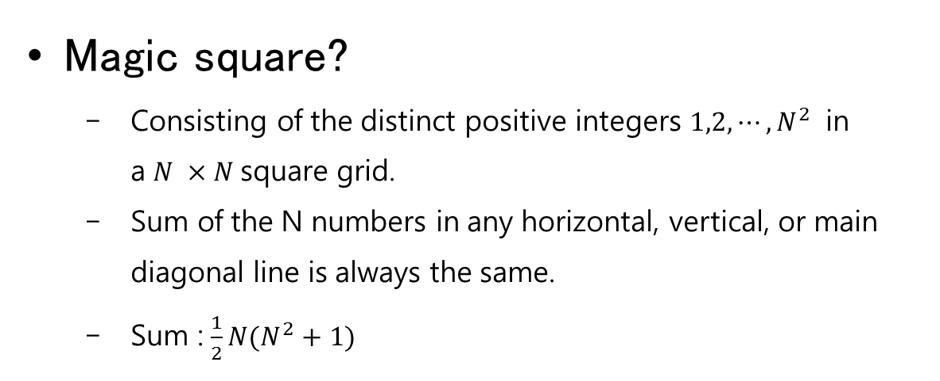
Magic Square?
16 | 3 | 2 | 13
5 | 10 | 11 | 8
9 | 6 | 7 | 12
4 | 15 | 14 | 1
4 | 9 | 2
3 | 5 | 7
8 | 1 | 6
Sum : 15
Sum : 34
Magic square?
Consisting of the distinct positive integers $1,2,⋯,N^{2}$ in a $N ×N$square grid.
Sum of the N numbers in any horizontal, vertical, or main diagonal line is always the same.
Sum : $\frac{1}{2}N(N^{2}+1)$

Slide 4
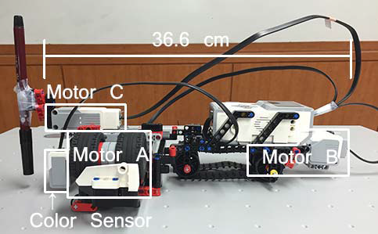
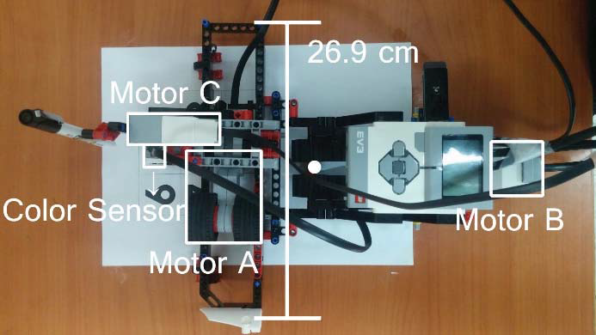
Robot Hardware
Platform
EV3 brick for controlling the entire parts.
2 large motors for movements.
1 medium motor for controlling a pen.
A color sensor for getting information.
Action
Motor A drive on the rail.
Motor A and B move in the directions of the x- and y-axes.
Color sensor and Motor C are attached to the motor A.
The center of gravity of the robot
white point

Slide 5
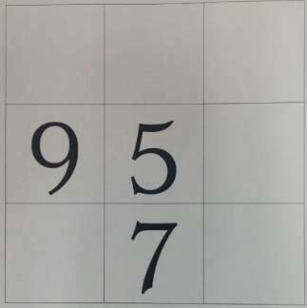
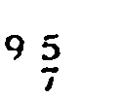
Robot Software (1/2)
1. Sensing(Scanning)
The color sensor measures the brightness
The brightness values have intensity from 0 and 100.
Our algorithm constructs an M by K array image.
2. Recognition
recognize the empty cells and the occupied cells.
0 ~ 100 -> 0 ~ 255(Grayscale) convert.
Gaussian filtering.
Smooth and remove the noise the image
Locally Adaptive thresholding.

Slide 6
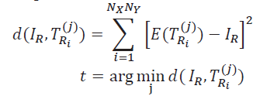
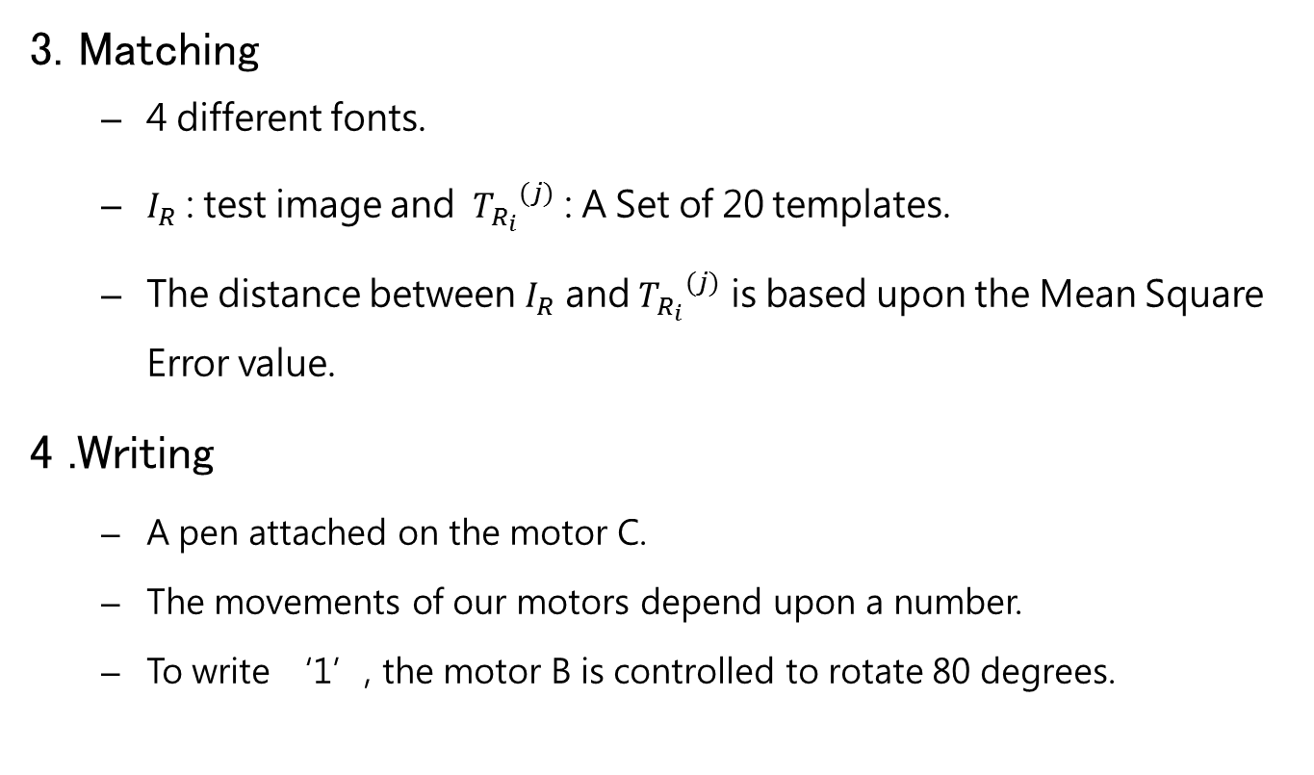
Robot Software (2/2)
3. Matching
4 different fonts.
$I_{R}$ : test image and ${T_{R_{i}}}^{(j)}$ : A Set of 20 templates.
The distance between $I_{R}$ and ${T_{R_{i}}}^{(j)}$ is based upon the Mean Square Error value.
4 .Writing
A pen attached on the motor C.
The movements of our motors depend upon a number.
To write ‘1’, the motor B is controlled to rotate 80 degrees.

Slide 7
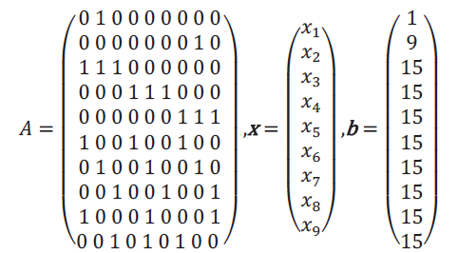
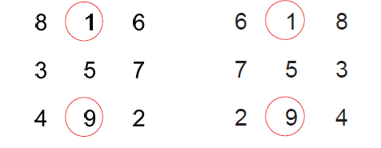


Analysis of Magic Square
The linear system in order to solve a magic square problem.
 | 1
 | 9
$$Ax=b$$
$x_{i} :[x_{1} 1 x_{3} ; x_{4}{ x}_{5} x_{6} ; x_{7} 9 x_{9}$]
Two solutions for the preoccupied numbers (1 and 9)

Slide 8
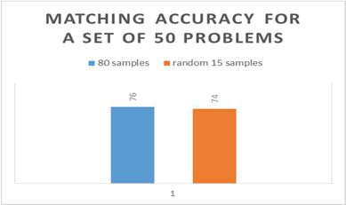
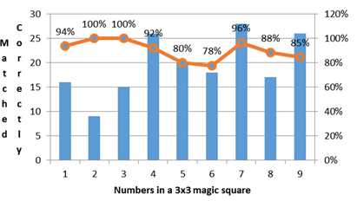
Experiment Results
Matching accuracy for a set of 50 problems
Matching Accuracy
Accuracy of matching. It is compared the use of 80 samples with 15 random samples.
Matching accuracy of each number from 1 to 9.

Slide 9
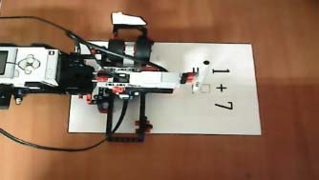
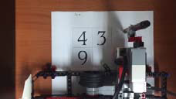





Experiment Results
$$①$$
$$②$$
Pen down
$$⑤$$
$$③$$
$$④$$
Pen up

Slide 10
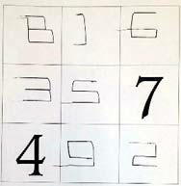
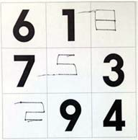
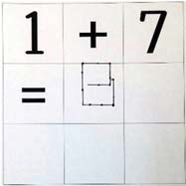
Experiment Results

Slide 11
Conclusion
This work presented a math-solving robot designed with EV3 components.
Our robot scanned a math problem and wrote the answer.
A linear system with the analysis of rank
Showed experiments for the purpose of math education.
For future work
enhance our robot system in both hardware/software design to achieve faster and accurate processing.
Use more robotic platforms for application for educational purpose.

Slide 12
Acknowledgement
This material is based upon work supported by the BK21 plus program through the National Research Foundation (NRF) funded by the Ministry of Education of Korea. Hyung-seok Lee and Hyo-Sang Lim are supported by a grant ‘Biotechnology & GMP Training Project’ from the Korea Institute for Advancement of Technology (KIAT), funded by the Ministry of Trade, Industry and Energy (MOTIE) of the Republic of Korea (N0000961).

